Slide 1
Hadoop Introduction
By Shalini Gupta

Slide 2
Objectives
Concept of scaling
Types of scaling
Understanding cluster
Computation of large data
Introduction to parallel and distributed computing
Overview of Hadoop ecosystem

Slide 3
What is Scaling?
Scaling is the ability of system to adapt to increase in demand of processing.
Types of scaling:
Horizontal scaling
Vertical scaling

Slide 4
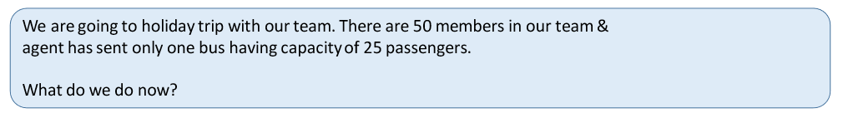

Why do we need scaling?

Slide 5
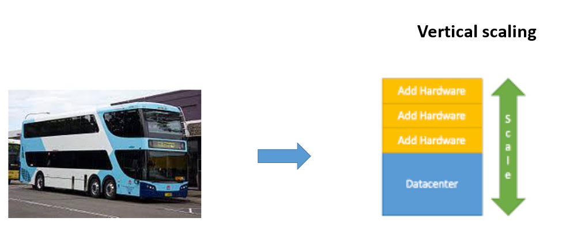
Vertical Scaling

Slide 6
Challenges of Vertical Scaling
Finance : Requires large amount of investments
Capacity of System : Requires powerful system to handle future workloads
Limit : After a limit, vertical scaling is not possible
Failure : It is a single point of failure.

Slide 7
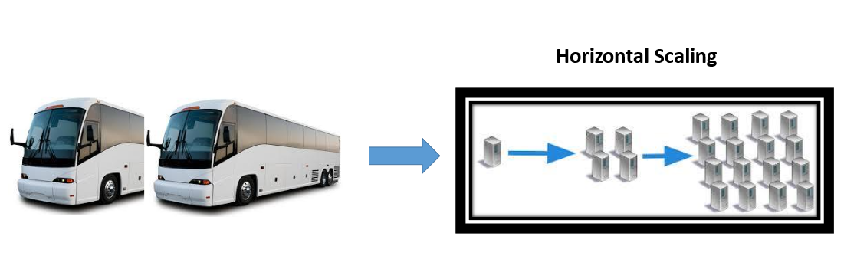
Horizontal Scaling

Slide 8
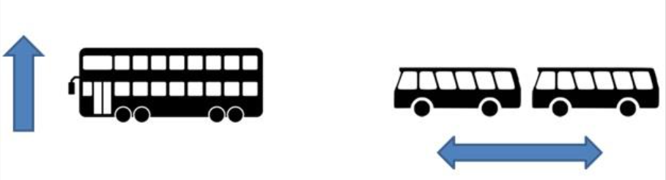
Scale Up Vs Scale Out
Scale Up- Vertical Scaling
Scale Out- Horizontal Scaling

Slide 9
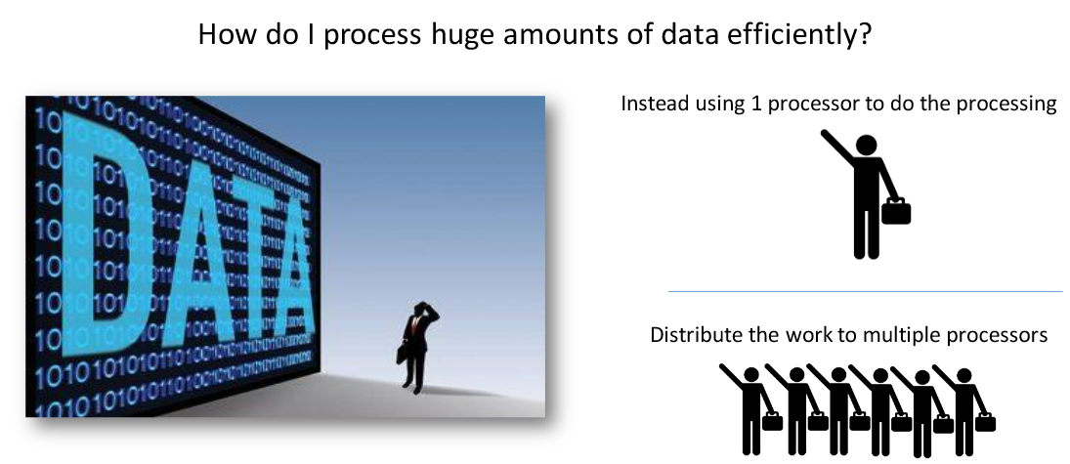
Computing Massive Amount of Data

Slide 10
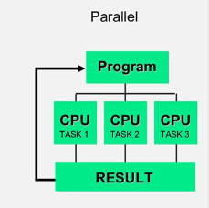
Parallel Computing
Single program is running by multiple CPU Cores
Programs are split and executed by several CPU at the same time.
Processed results are then combined.

Slide 11
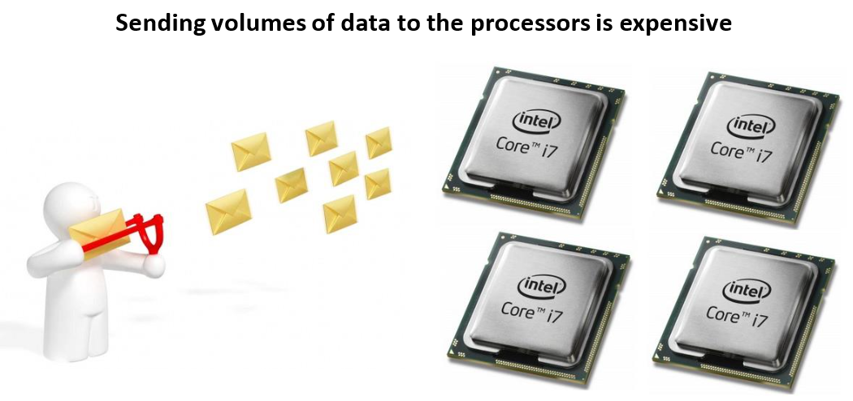
Challenge of Parallel Computing

Slide 12
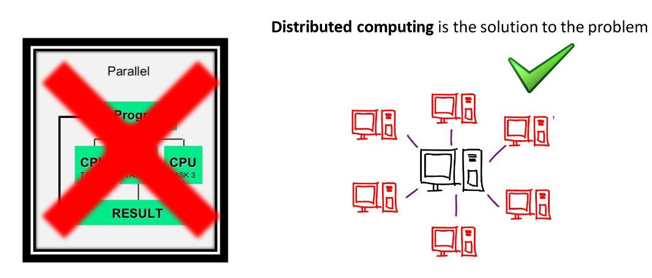
Solution – Distributed Computing

Slide 13
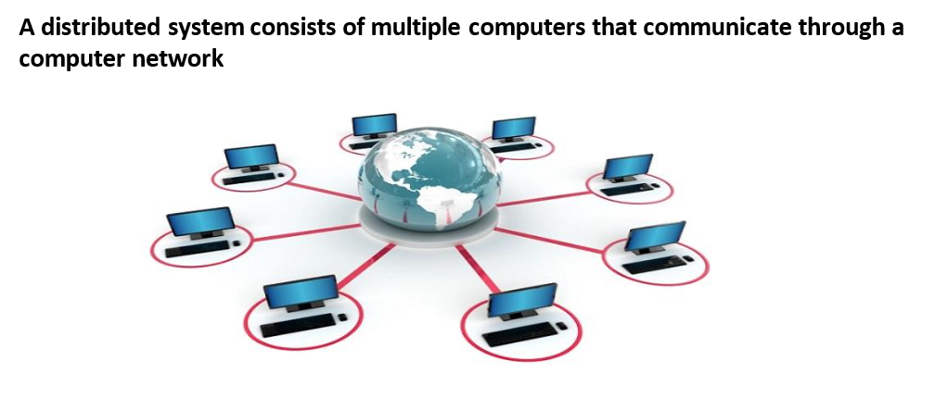
What is Distributed Computing?

Slide 14
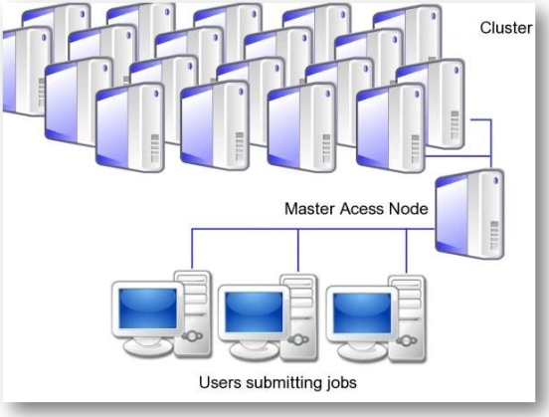
Need for Distributed Computing
Distributed computing servers store data in local file systems and built using the commodity hardware.

Slide 15
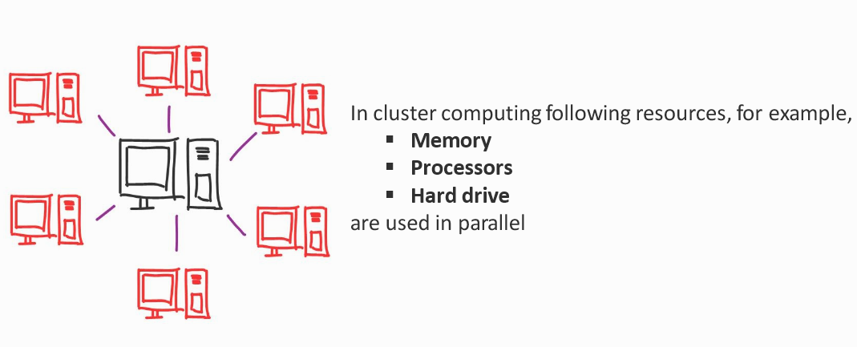
Distributed Computing

Slide 16
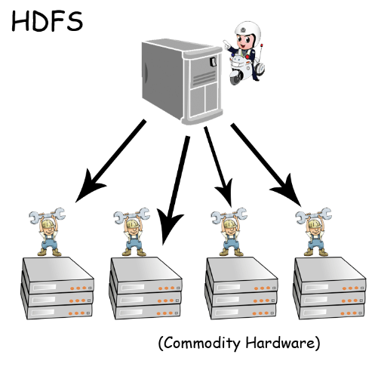
Implementation of Distributed Computing: Hadoop
Hadoop stores data on HDFS(Hadoop Distributed File System).
Hadoop Cluster is built on commodity hardware.

Slide 17
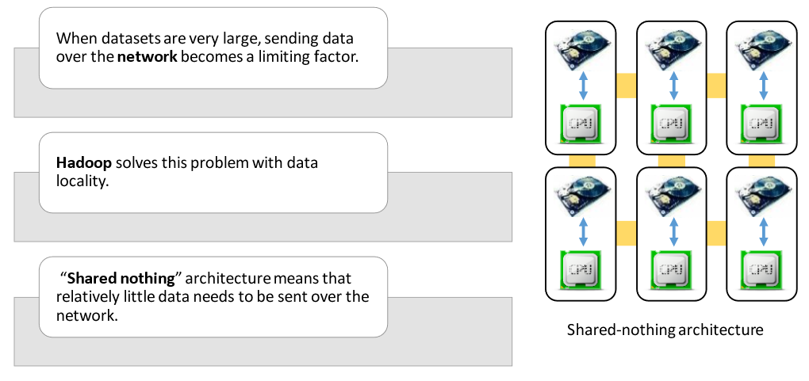
Shared- nothing Architecture

Slide 18

Data Locality
Data locality refers to the process of placing computation near to data, which helps in
High throughput
Faster execution of data

Slide 19
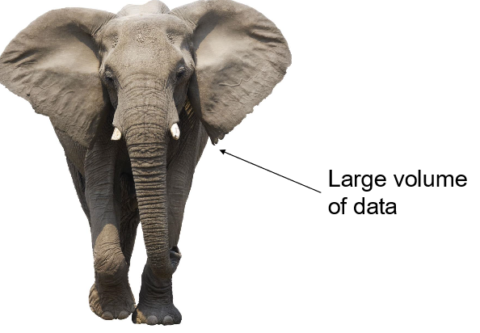
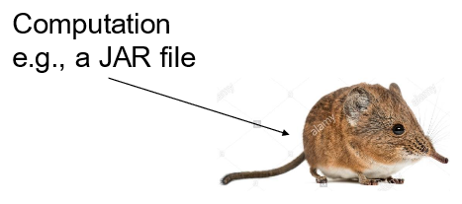
Smart Work: Send Program to Data

Slide 20

Framework of Big Data - Hadoop

Slide 21
Hadoop
Popular framework for distributed parallel processing.
Provides easy horizontal scalability.
Distributed storage on commodity hardware.
Provides parallel processing for faster execution on massive datasets.

Slide 22

Some Tools in World of Hadoop

Slide 23
Hadoop Ecosystem with Life – Cycle of Big Data Project

Slide 24
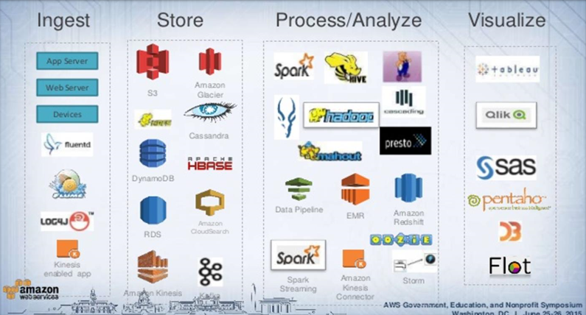

Slide 25
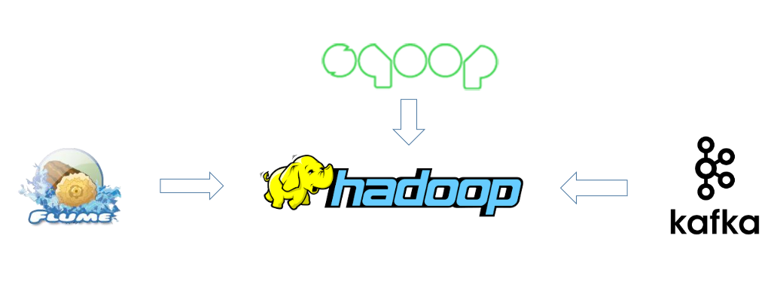
Ingest: Bringing data in Hadoop

Slide 26
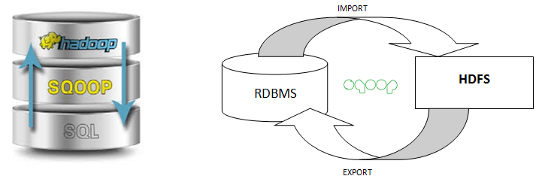
Sqoop: Import and export structured data

Slide 27
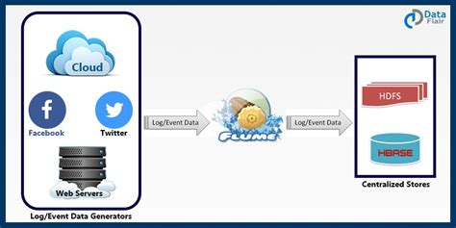
Flume: Ingests unstructured/semi-structured data (log data)

Slide 28
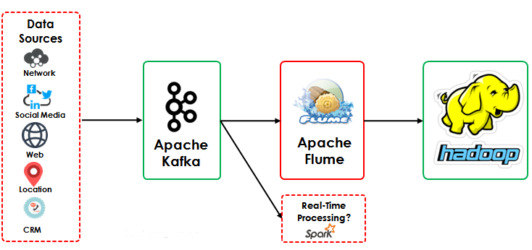
Kafka: Brings unstructured data via message queue

Slide 29
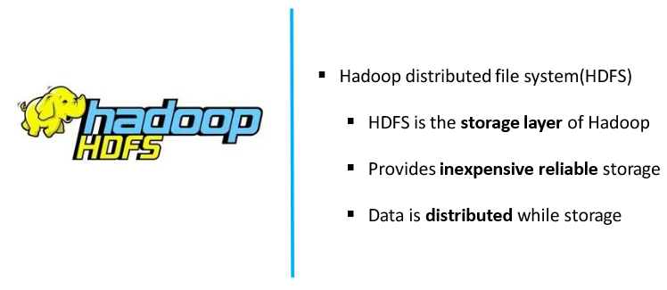
Store: How data is stored and queries in Hadoop

Slide 30
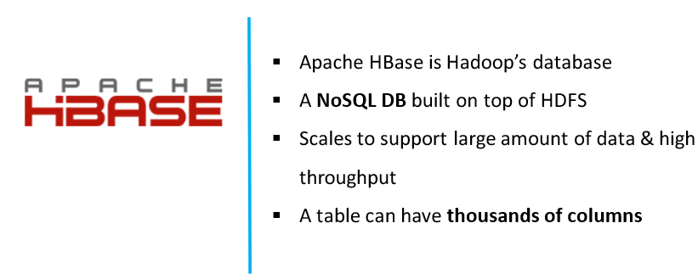
Store: How data is stored and queries in Hadoop

Slide 31
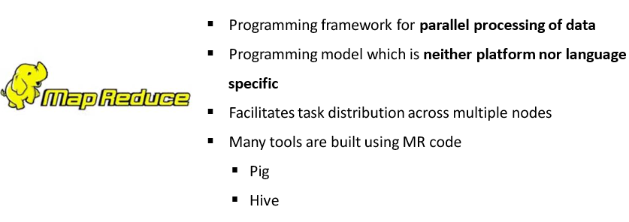
Process: MapReduce – Data Processing Engine for Hadoop

Slide 32
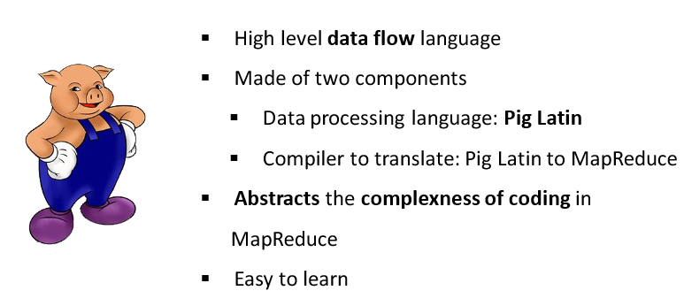
Process: Query data using Apace Pig Scripts

Slide 33
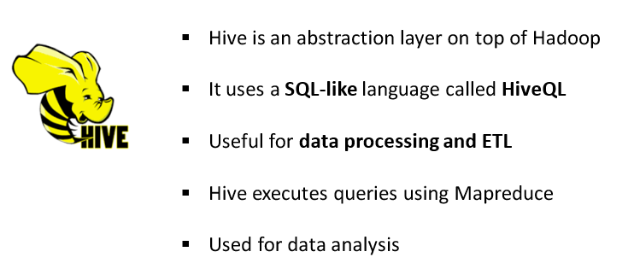
Process: Query data like SQL using Apache Hive

Slide 34
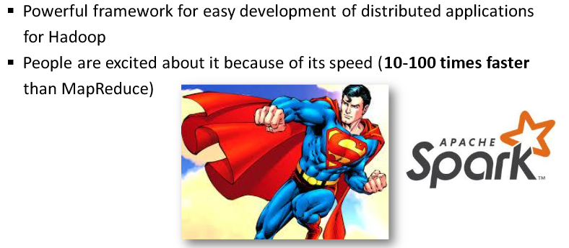
Process: Fast Processing using Apache Spark

Slide 35
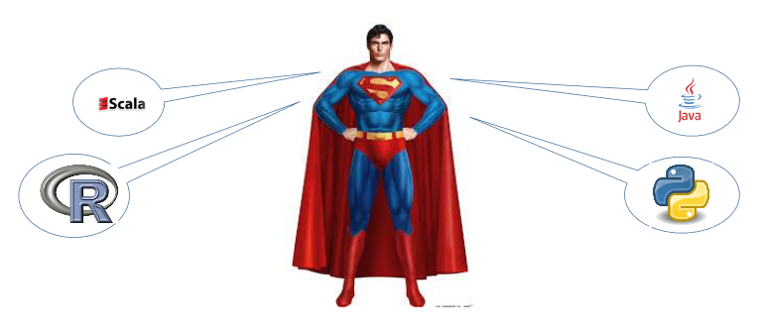
Spark: Different Language in one Place

Slide 36

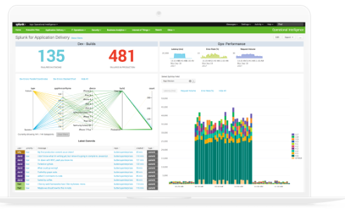


Visualize

Slide 37
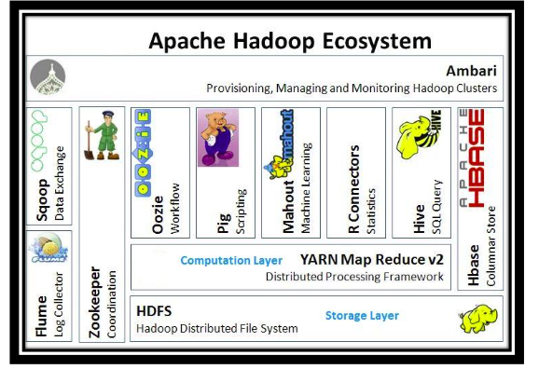
Hadoop Ecosystem

Slide 38
Thank You!

